Slide 1
SEC285 -Course Project
Fundamentals of Information System Security
By: Jeffrey Fang

Slide 2
Introduction
This course explores the fundamentals of information security attacks and defense mechanisms.
Security issues related to people, data, networks, and devices are surveyed to provide insight into designing security solutions and policies.
Technologies and practices that support the security principles of confidentiality, integrity, and availability are also discussed. ​

Slide 3
Asymmetric Key Encryption
Explore technical and administrative controls using encryption.
Secure file management is implemented to mitigate risks to enterprise data assets.

Slide 4
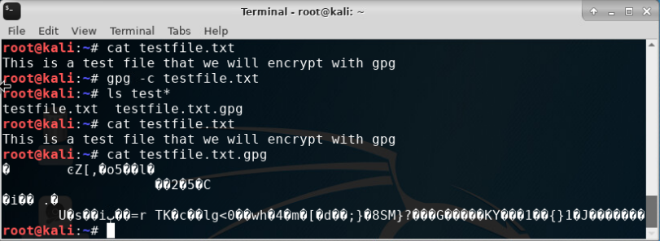
File Encryption
This screenshot shows the following.
Content of the plaintext file
Content of the encrypted file

Slide 5
File Decryption
This screenshot shows the following.
The encrypted file being listed by itself
The decrypting process
Both the encrypted file and the original plaintext file being listed

Slide 6
Stateful Firewall
Explore how firewall is used to protect enterprise computing resources from attacks

Slide 7
Question
What effect does the sudo iptables --policy INPUT DROP command have on the access to computing resources?
Answer here:
Display options of the command that are available to implement and manage the firewall
It monitors traffic to and from your server with tables.
The tables are a set of rules that filter in and out going data packets
References: Module 3 lab
https://www.hostinger.com/tutorials/iptables-tutorial

Slide 8
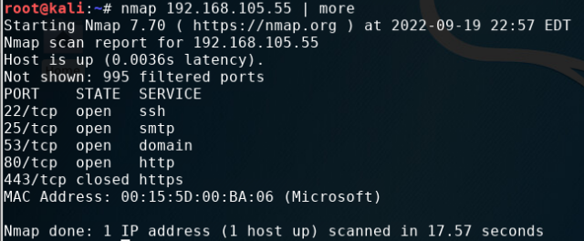
Nmap Scan
This screenshot shows the Nmap scan result of the Linux Server VM.

Slide 9
Bring Your Own Device (BYOD) Security Policy
Create the bring your own device (BYOD) security policy for ABC Corporation based on a SANS security policy template
Click on Microsoft Word Document to view.

Slide 10
Multi Factor Authentication (MFA)
Implement security controls to protect enterprise computing resources, by using multi factor authentication (MFA).

Slide 11
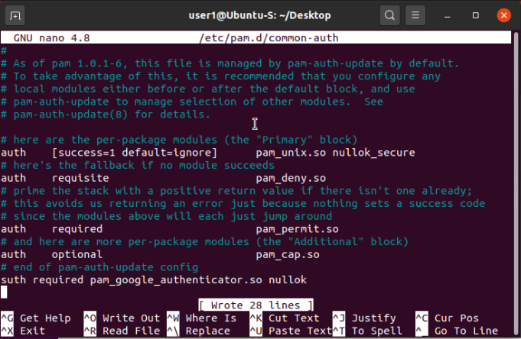
Common-auth Configuration File
This screenshot shows the entry that indicates the use of the Google Authenticator module.

Slide 12
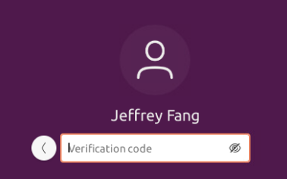
MFA Logon Screen
This screenshot shows the logon screen where a verification code is required.

Slide 13
Vulnerability Assessment
Implement security controls to protect enterprise computing resources, by using multi factor authentication (MFA).

Slide 14
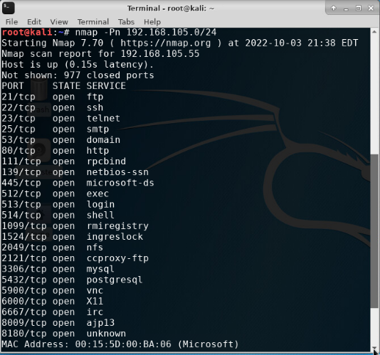
Nmap
This screenshot include the scan result showing both the Kali and Linux Server VMs.

Slide 15
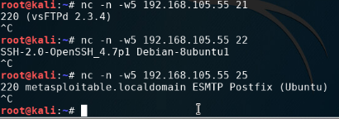
NetCat
This screenshot include the scan result showing both the Kali and Linux Server VMs.

Slide 16
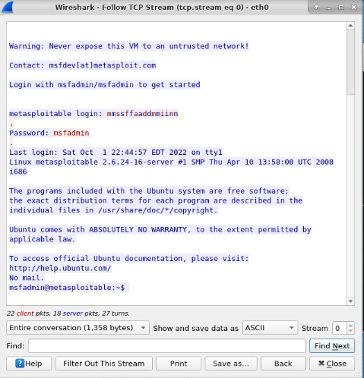
Wireshark
This screenshot include the Wireshark—Follow TCP Steam window showing the Telnet username and password.

Slide 17
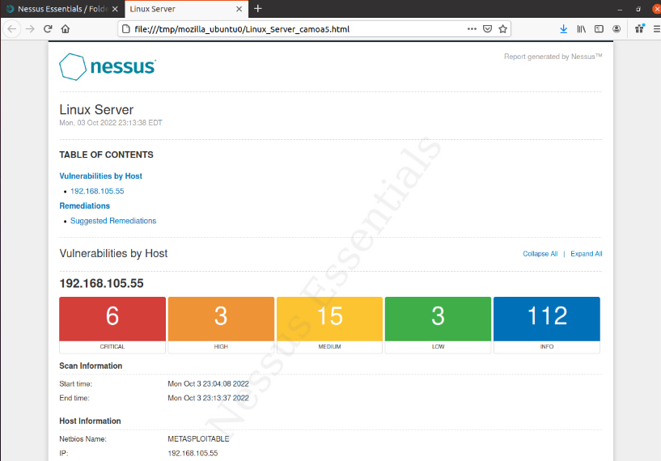
Nessus
This screenshot include the high-level view of the Nessus vulnerability scan report (showing categories of vulnerability in different colors).

Slide 18
Career Skills
Describe different types of malware.
Identify social engineering attacks.
Survey network security devices and protocols.
Explain wireless network security solutions.
Interpret application security, device security, and physical security.
Examine authentication and access control techniques.
Assess business continuity and risk management strategies.
Produce a secure network.

Slide 19
Challenges
Interpreting and Identifying the needs of the company when creating the BYOD policy.
Understanding the NetCat and NetScan
Terminologies throughout the course

